Slide 1
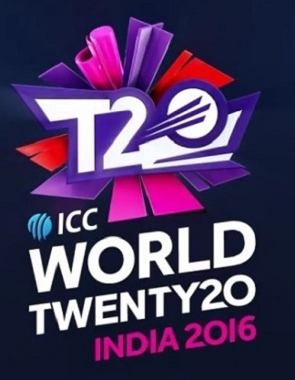
T20 World Cup 2016 Analysis
Data Science Lab – I Project
PRESENTATION BY GROUP 16
Rajdeep Adhya
Abhraraj Haldar
Vanshika Gupta
Pravin Raman Bharti
Under the guidance of Dr. Dootika Vats

Slide 2

From where we scrapped our data?
https://www.espncricinfo.com/series/world-t20-2015-16-901359

Slide 3
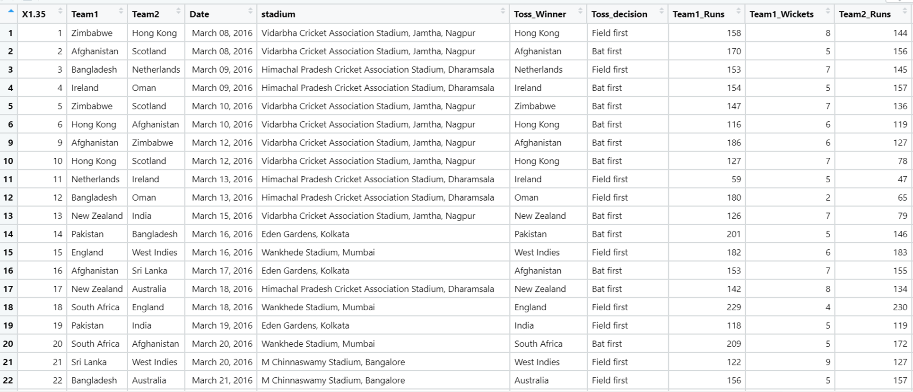
How does Our Dataset look?

Slide 4
Data Details
Our data is based on T20 Worldcup, 2016.
Our data contains 33 rows and 13 columns.
Various variables are Team1, Team2, Date, Stadium, Toss_winner, Toss_decision, Team1_runs, Team1_wickets, Team2_runs, Team2_wickets, Match_winner and POM.
Also, we have scrapped data on the scorecard of all the matches played by the four semi-finalist teams namely,
India
New Zealand
West Indies
England

Slide 5
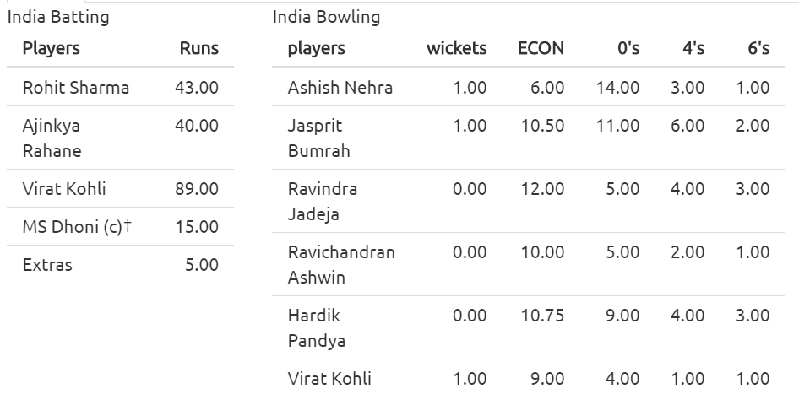
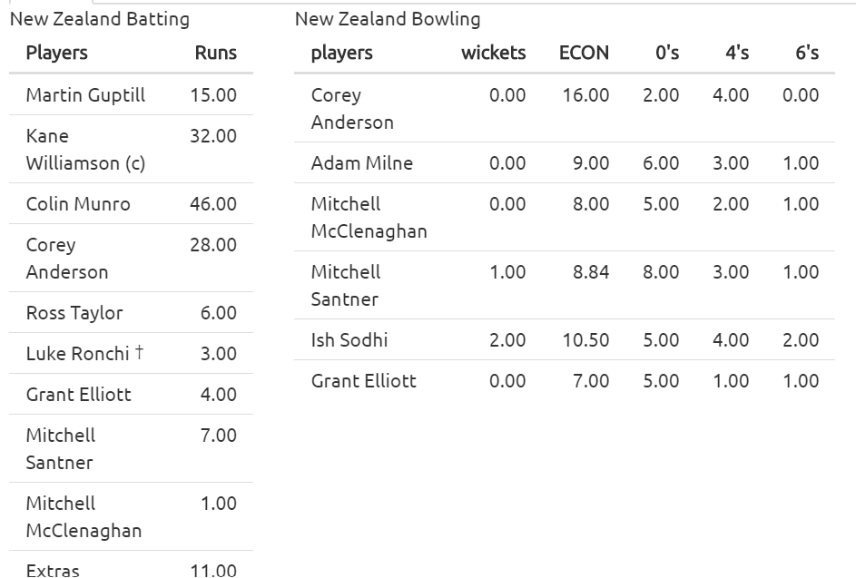
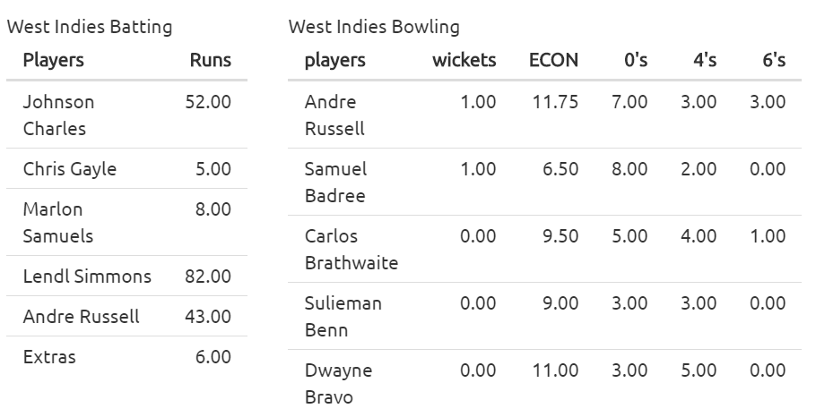
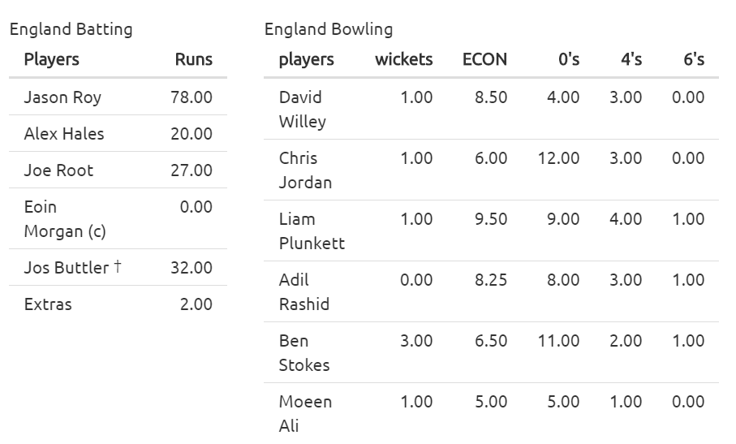
India VS West Indies, March 31, 2016
New Zealand VS England, March 30, 2016

Slide 6
Libraries we used
tidyverse
rvest
ggplot2
dplyr
patchwork

Slide 7
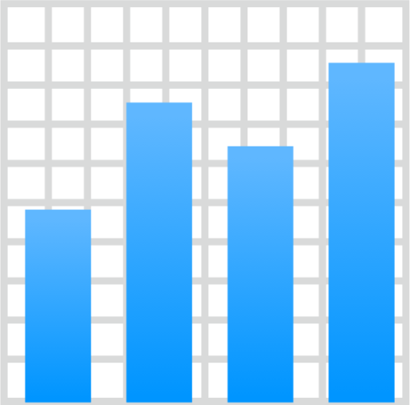
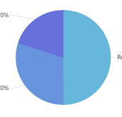
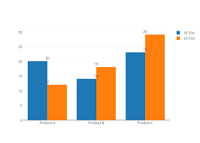
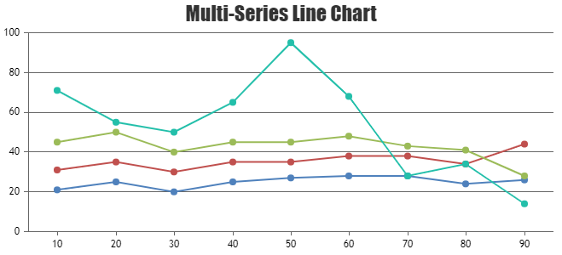

Plots we used to make visualizations and analysis
Bar diagram
Pie chart
Multiple Bar diagram
Multiple Line diagram
Line diagram

Slide 8

Why did we choose this data?

Slide 9





Questions we want to answer through our data visualizations
1. Did a particular stadium played an important role in winning the match through a toss win?
2.
3.
4.
5.

Slide 10
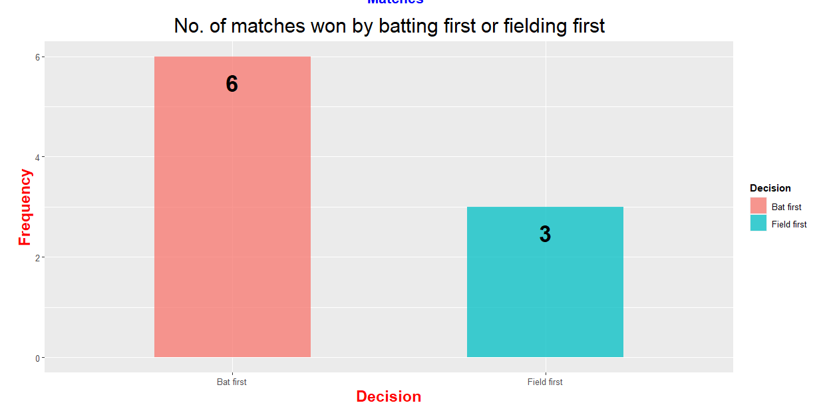
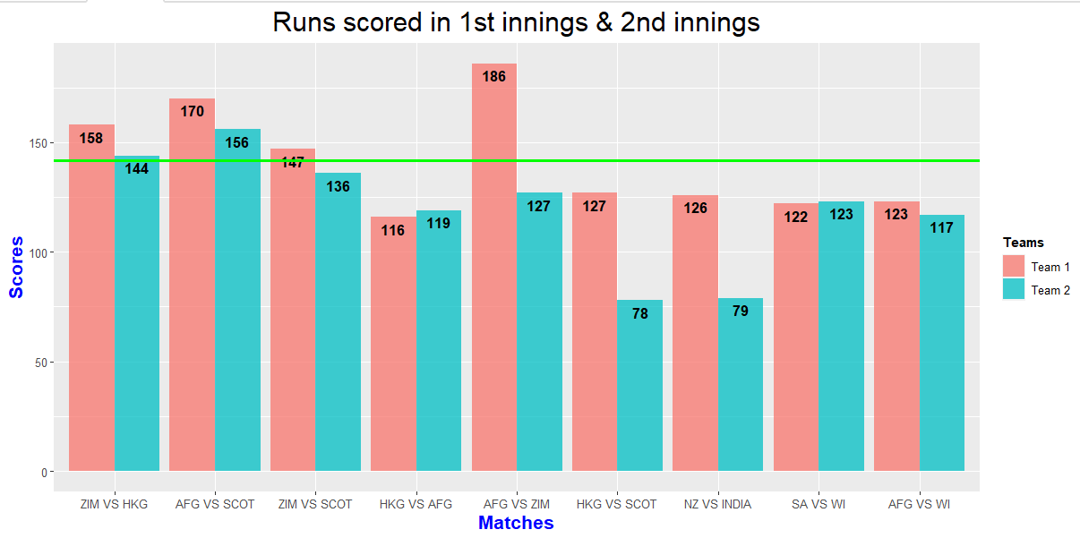
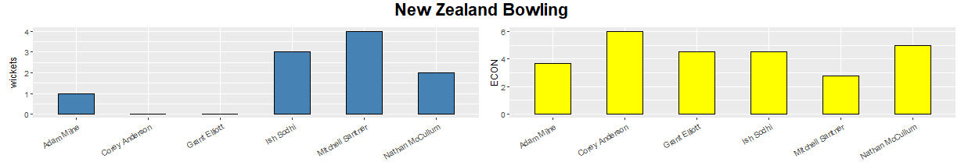
Vidarbha Cricket Association Stadium, Jamtha, Nagpur
New Zealand VS India , March 15, 2016

Slide 11
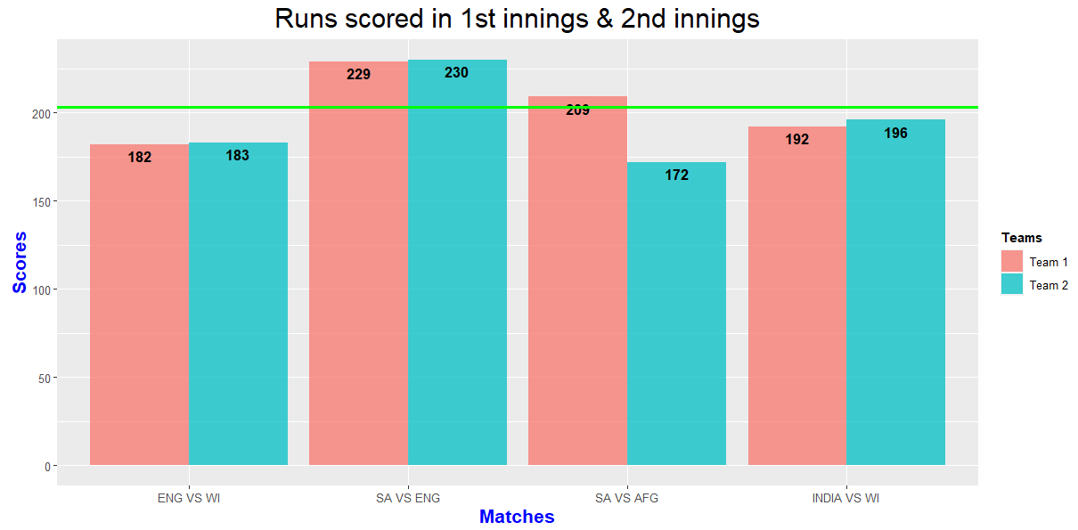
Wankhede Stadium, Mumbai

Slide 12
Questions we want to answer through our data visualizations
1. Did a particular stadium played an important role in winning the match through a toss win?
2. Had the toss been an important factor in winning a match throughout the tournament?
3.
4.
5.

Slide 13
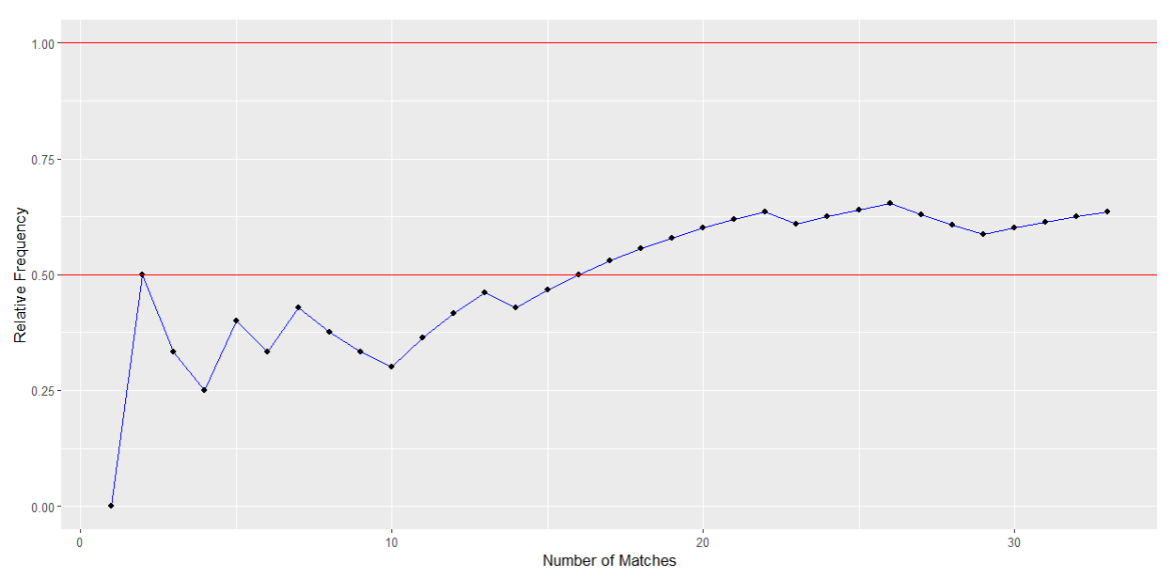
$$\frac{Number of matches where the team which wins the toss also wins the match}{Total number of matches}$$

Slide 14
Questions we want to answer through our data visualizations
1. Did a particular stadium played an important role in winning the match through a toss win?
2. Had the toss been an important factor in winning a match throughout the tournament?
3. What is the cause of the loss of the hosting country India?
4.
5.

Slide 15
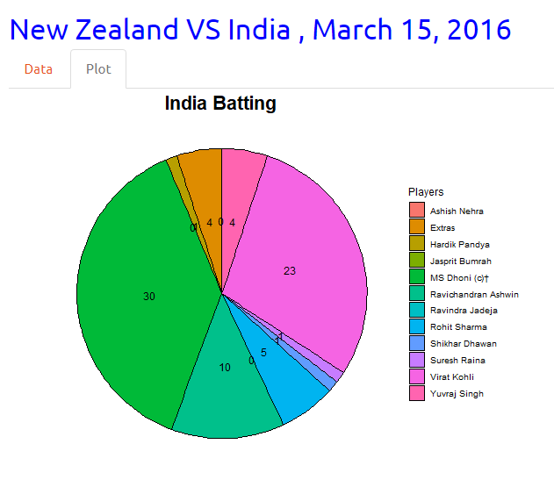
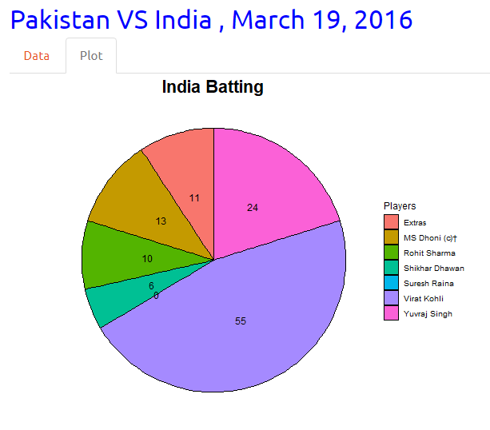
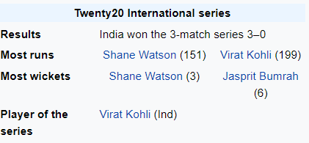
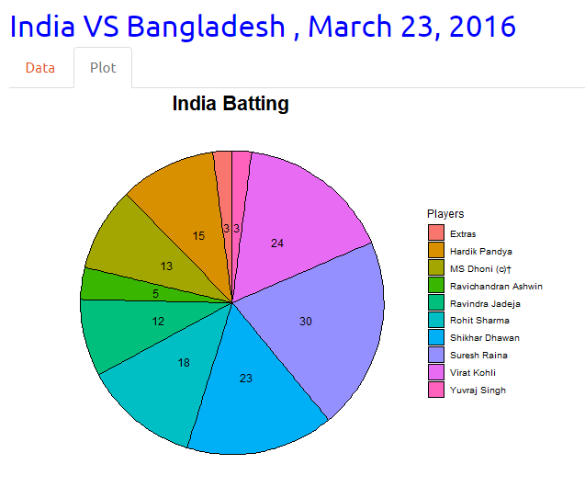
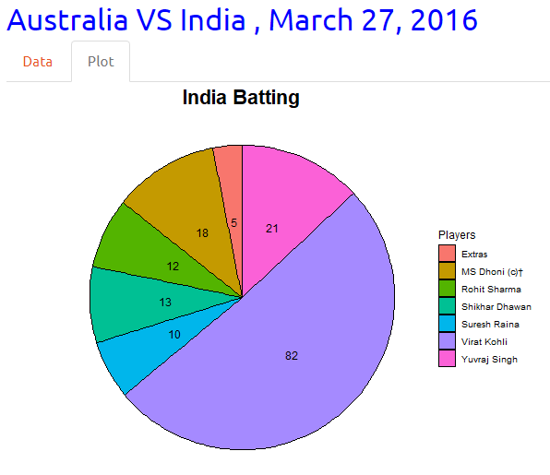

Slide 16
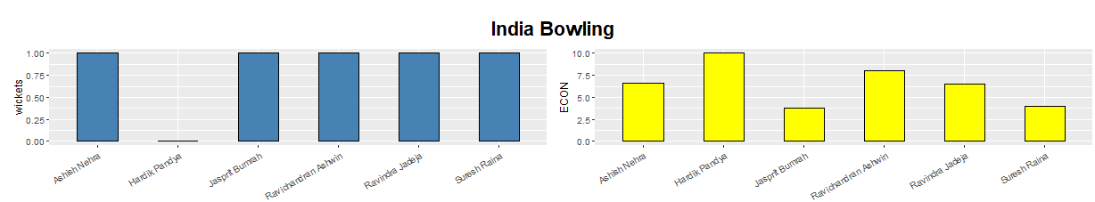
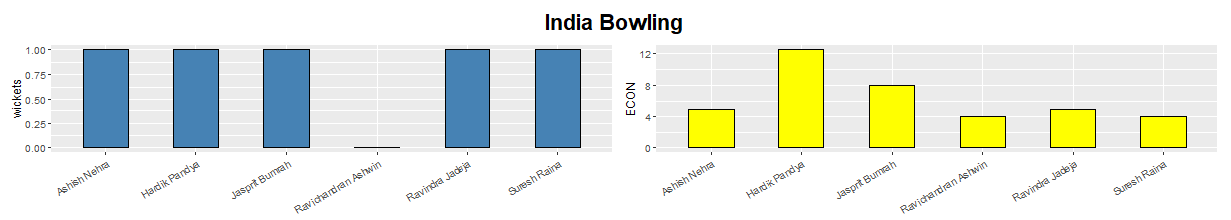
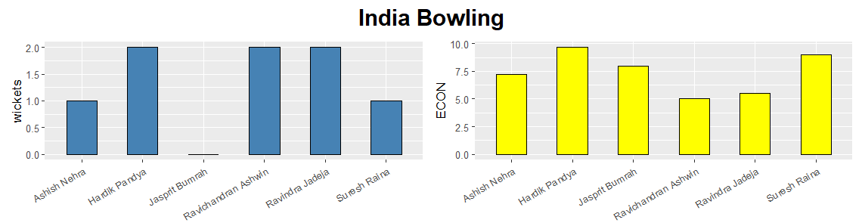
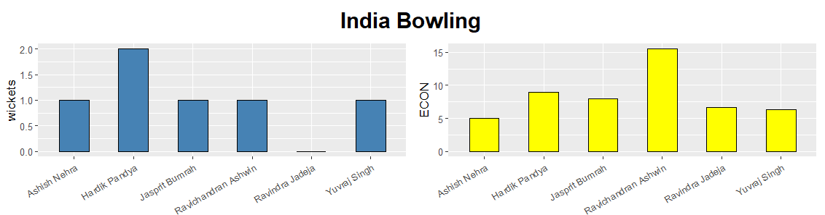
New Zealand VS India, March 15, 2016
Pakistan VS India, March 19, 2016
India VS Bangladesh, March 23, 2016
Australia VS India, March 27, 2016

Slide 17
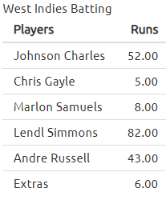
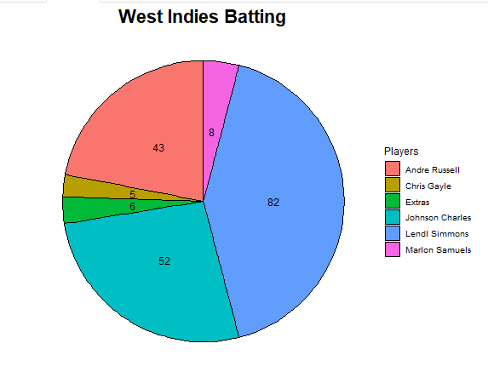
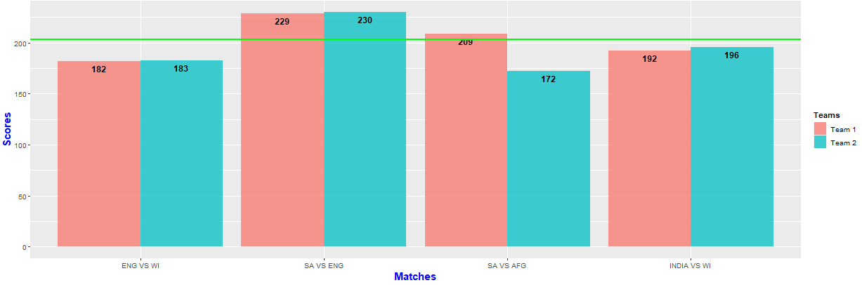
India VS West Indies, March 31, 2016
Wankhede Stadium, Mumbai

Slide 18
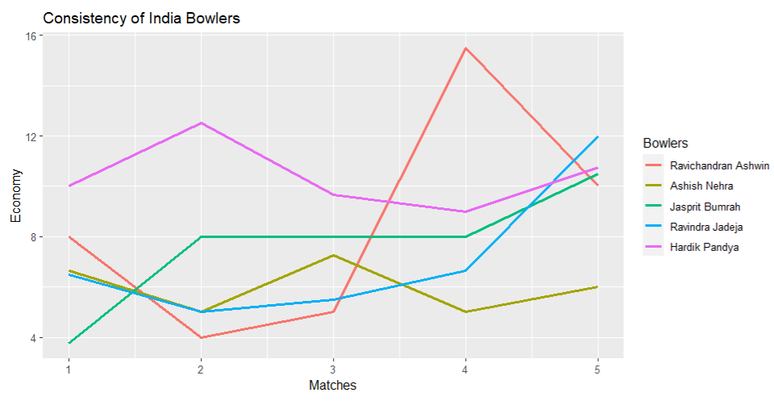
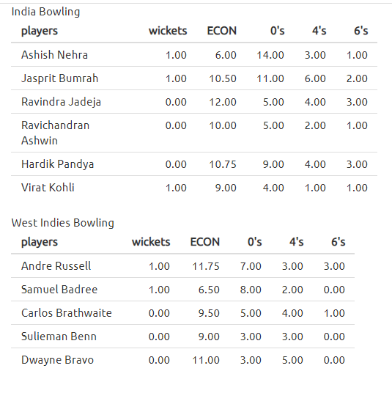

Slide 19
Questions we want to answer through our data visualizations
1. Did a particular stadium played an important role in winning the match through a toss win?
2. Had the toss been an important factor in winning a match throughout the tournament?
3. What is the cause of the loss of the hosting country India?
4. What was the cause of losing the semi-final of New Zealand?
5.

Slide 20
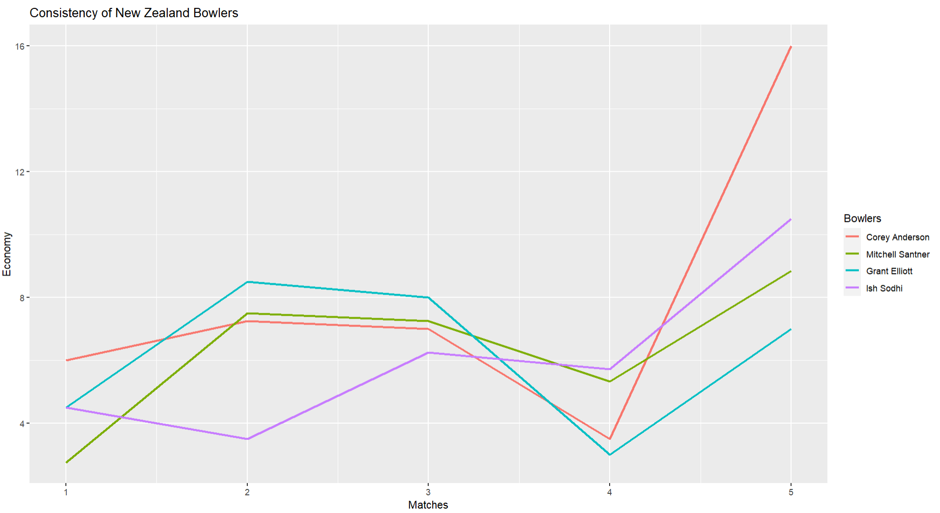

Slide 21
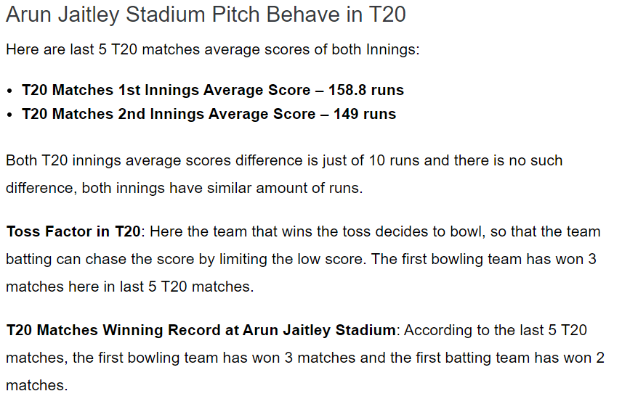

Slide 22
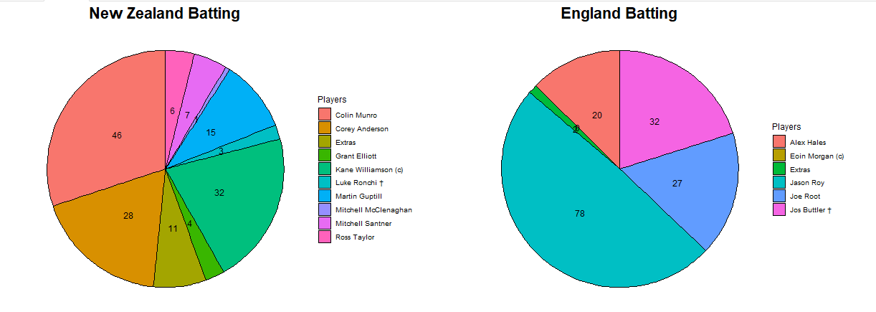
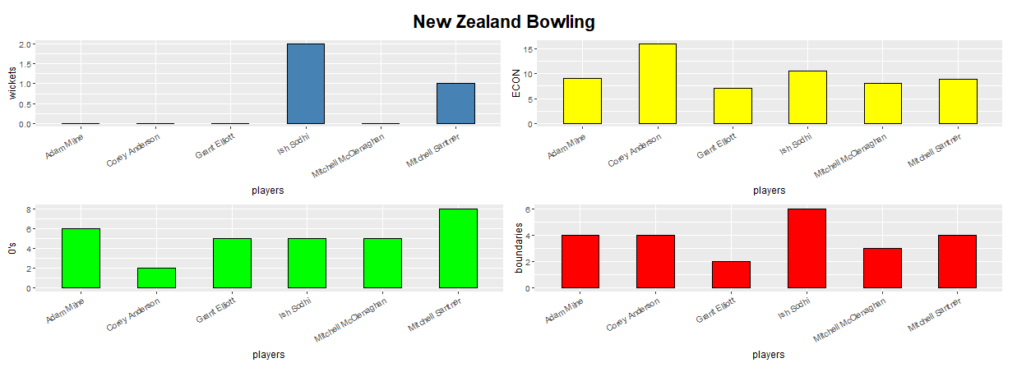
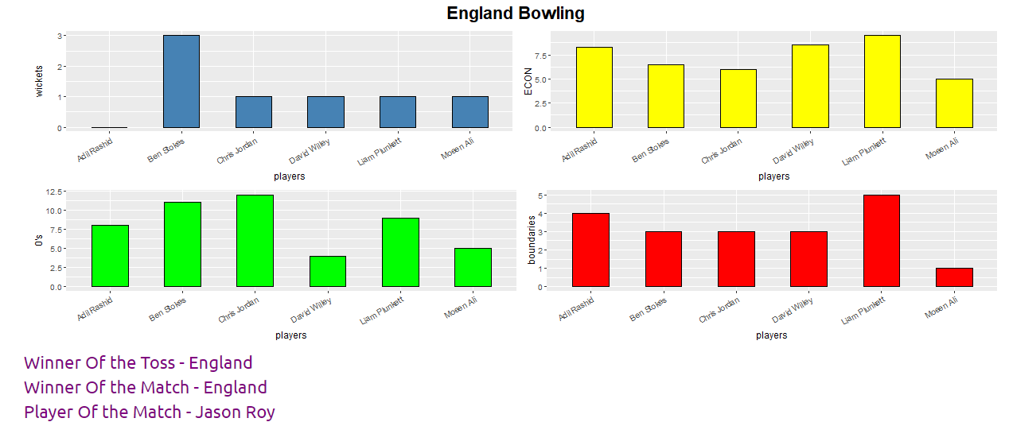

Slide 23
Questions we want to answer through our data visualizations
1. Did a particular stadium played an important role in winning the match through a toss win?
2. Had the toss been an important factor in winning a match throughout the tournament?
3. What is the cause of the loss of the hosting country India?
4. What was the cause of losing the semi-final of New Zealand?
5. What is the cause of the West Indies team being the champion of the T20 Worldcup 2016?

Slide 24
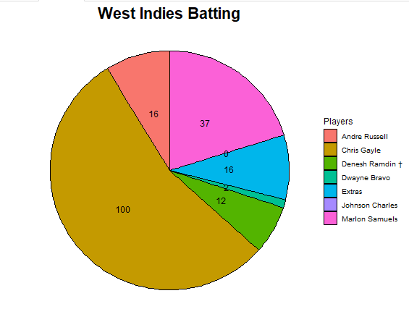
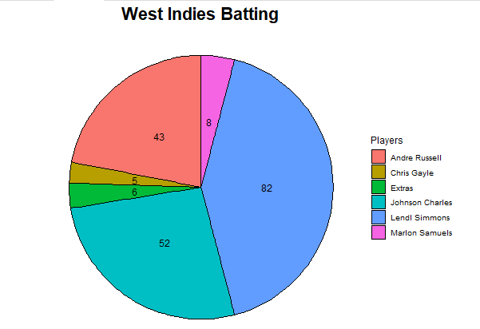
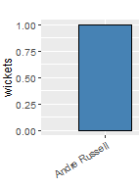
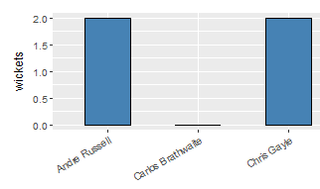
England VS West Indies, March 16, 2016
India VS West Indies, March 31, 2016
South Africa VS West Indies

Slide 25
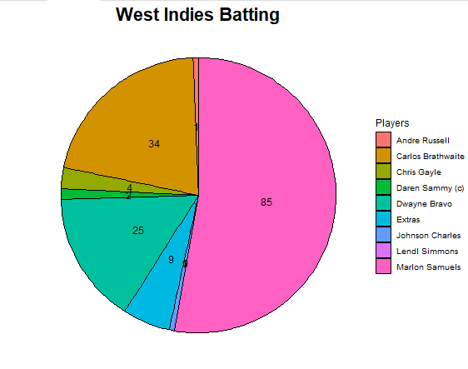
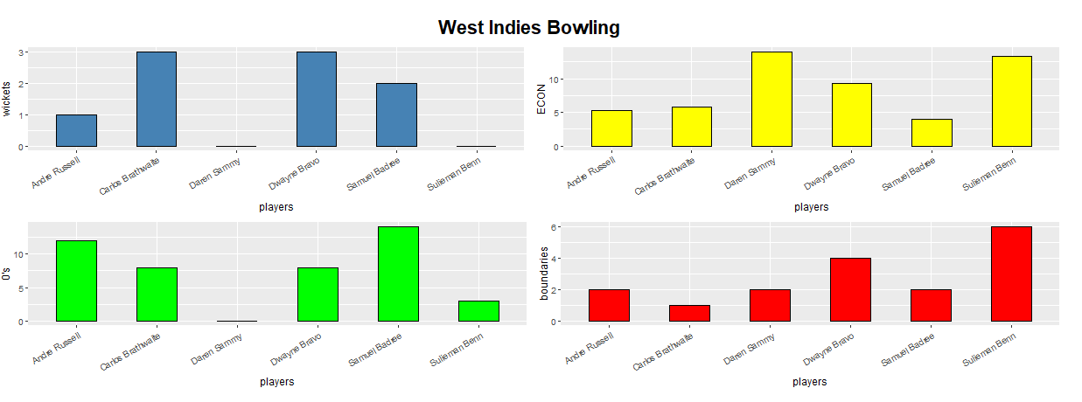
England VS West Indies, April 03, 2016

Slide 26
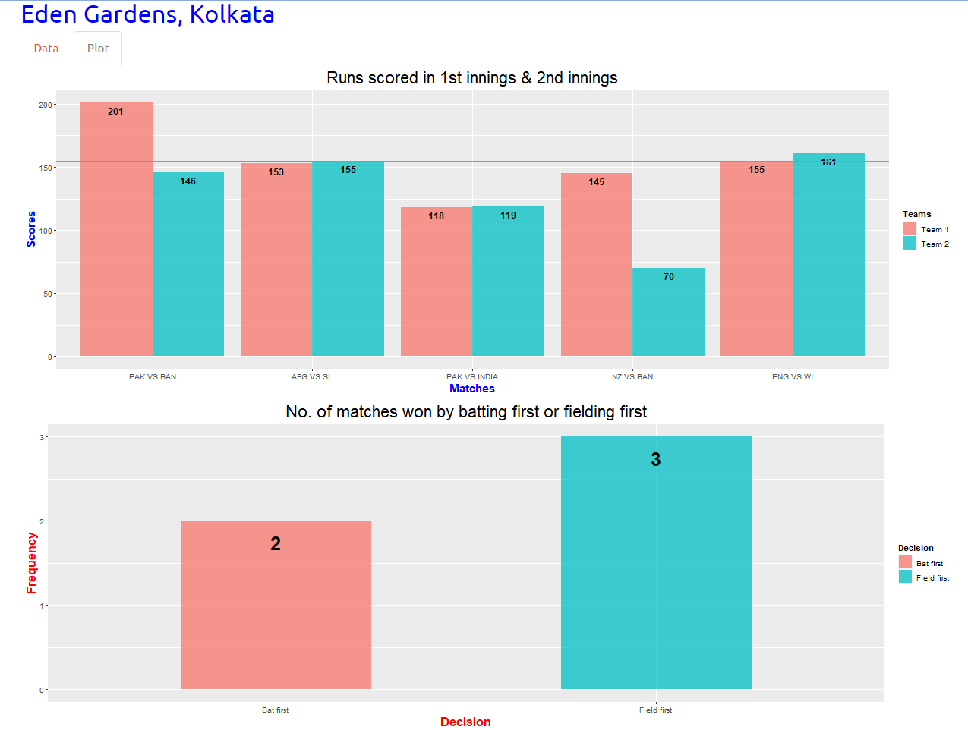

Slide 27
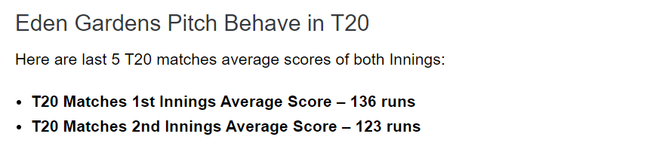
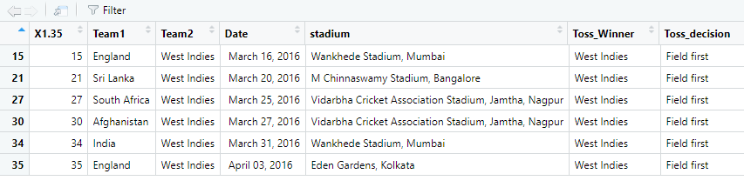

Slide 28
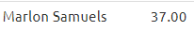
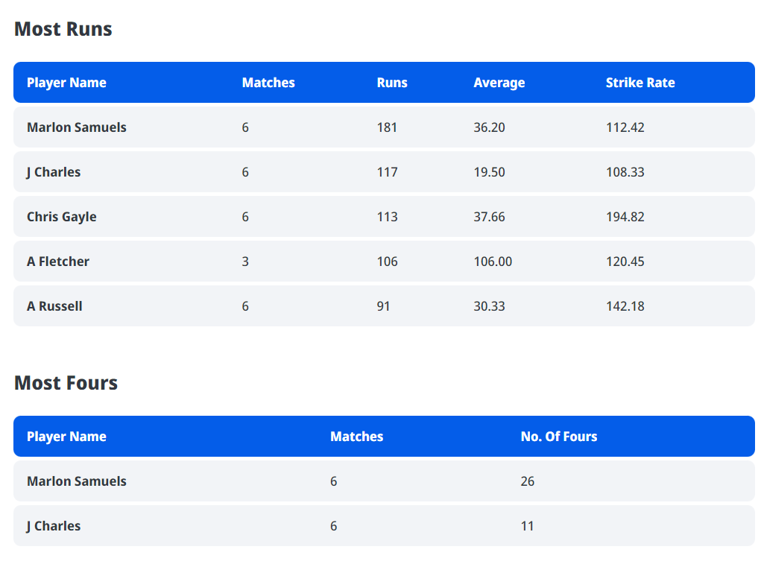
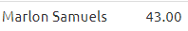
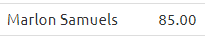
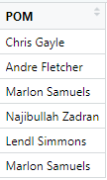

Slide 29
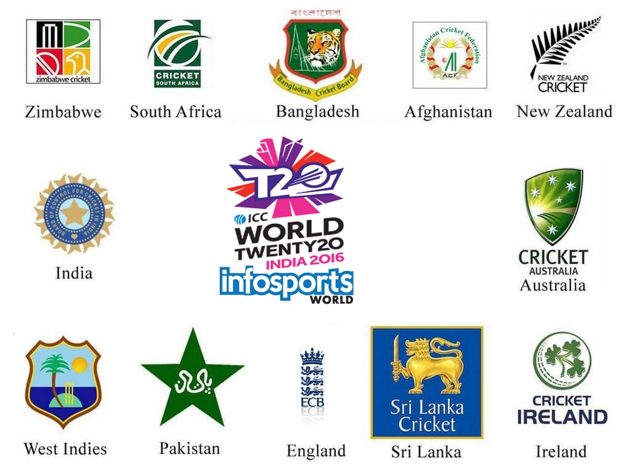
SHINY APP

Slide 30
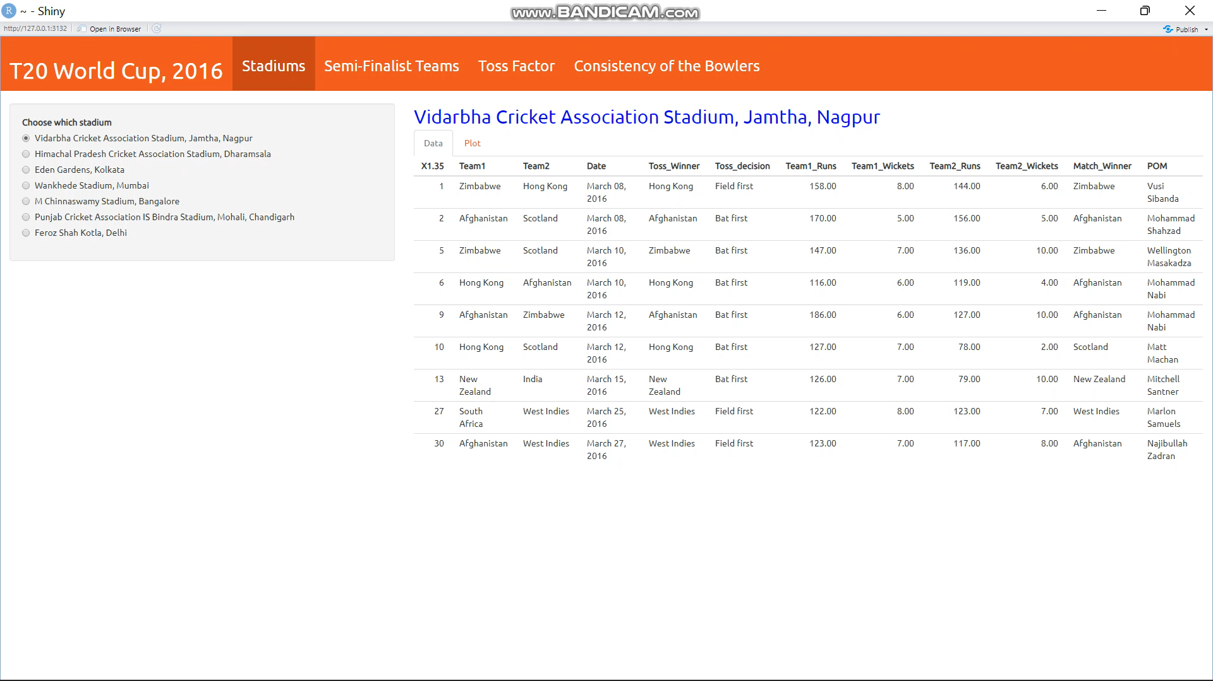

Slide 31

Thank you

